Slide 1
Stats to Show Your Stakeholders: The Business Case for Plain Language
STEAL THESE SLIDES: SHARE FAR & WIDE

Slide 2
9 Out of 10 Adults Have Difficulty Understanding and Using Available Health Information
National Center for Education Statistics
Notes:
Aha Media Group was founded in 2005, driven by the critical need for plain language in healthcare communication. A need highlighted by the personal health journey of owner Ahava Leibtag. Her experience underscored the challenge within healthcare content: the dominance of professional jargon over accessible, empathetic language. We advocate for consumer-centered plain language, recognizing its importance in making health information understandable for everyone. This commitment is reinforced by observing trends that impact content accessibility:
Decreasing attention spans
Lower literacy rates
Smaller screen sizes
Through research and advocacy, we strive to empower our clients to focus on the needs of their audience by adopting clear and concise communication.
Now, in 2024, there is near consensus that patients require clear content that helps them find what they need, understand what they find and move to the next step. This is the definition of plain language.

Slide 3
Do Healthcare Professionals Feel the Same Way?
Notes:
In our work with healthcare organizations, we consistently encounter tension between marketers and physicians.
Physicians often push for academic language to convey expertise, influencing the content in a way that may not be reader-friendly.
We see this in the intricate, jargon-heavy material found online, authored by experts who are knowledgeable in their fields but may not specialize in content creation.
Recognizing this gap, we launched new research to answer a critical question: Do physicians also benefit from plain language in content, helping them make confident decisions without the complexity of academic jargon?

Slide 4
We Wondered …
Do healthcare professionals prefer plain language when reviewing marketing materials?
Does plain language impact on someone taking action when reviewing B2B healthcare marketing materials?
How important is plain language for the B2B healthcare purchasing process?
Notes:
We conducted three studies to test our belief that straightforward communication is more effective in healthcare, even among physicians.
Our results confirmed that clear, actionable messaging is preferred, even in the complex world of healthcare. This applies to marketing and sales communication and also to physician-to-physician interactions such as referrals.
Complicated messages filled with jargon alienate your audience, as our research shows. Clear communication builds trust, an essential component in professional relationships. Our findings suggest that using clear and concise content can strengthen your connections with colleagues and peers in healthcare.

Slide 5
8 Out of 10 Highly Educated Decision-Makers Prefer Plain Language
Notes:
Our research indicates that 80% of healthcare decision-makers choose plain language over technical jargon. Clear content prompts action. The term ‘plain language' often confuses professionals, but it's not about oversimplification; it's about clear, direct communication. It enables readers to:
Find information
Understand and use it
Act on it
Consider personal experiences with new vendors or services. You likely acted on straightforward content because it was easy to understand immediately.
Professionals, like consumers, prefer clear content. For effective communication, content should be:
Direct
Use bullet points
Be scannable
Avoid jargon
Use familiar terms
Our research supports that content aligned with these preferences yields better engagement and responses.

Slide 6
One Example From the Research
Notes:
In our work with healthcare organizations, we consistently encounter tension between marketers and physicians.
Physicians often push for academic language to convey expertise, influencing the content in a way that may not be reader-friendly.
We see this in the intricate, jargon-heavy material found online, authored by experts who are knowledgeable in their fields but may not specialize in content creation.
Recognizing this gap, we launched new research to answer a critical question: Do physicians also benefit from plain language content, helping them make confident decisions without the complexity of academic jargon?

Slide 7
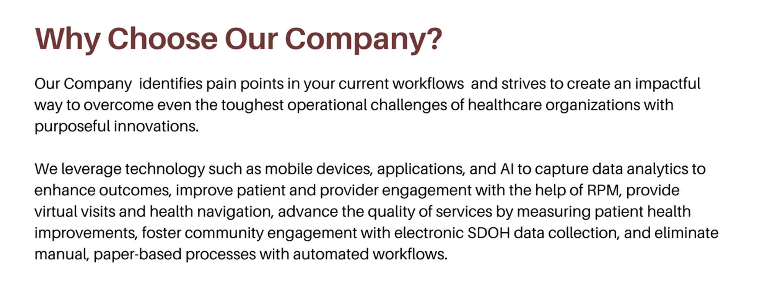
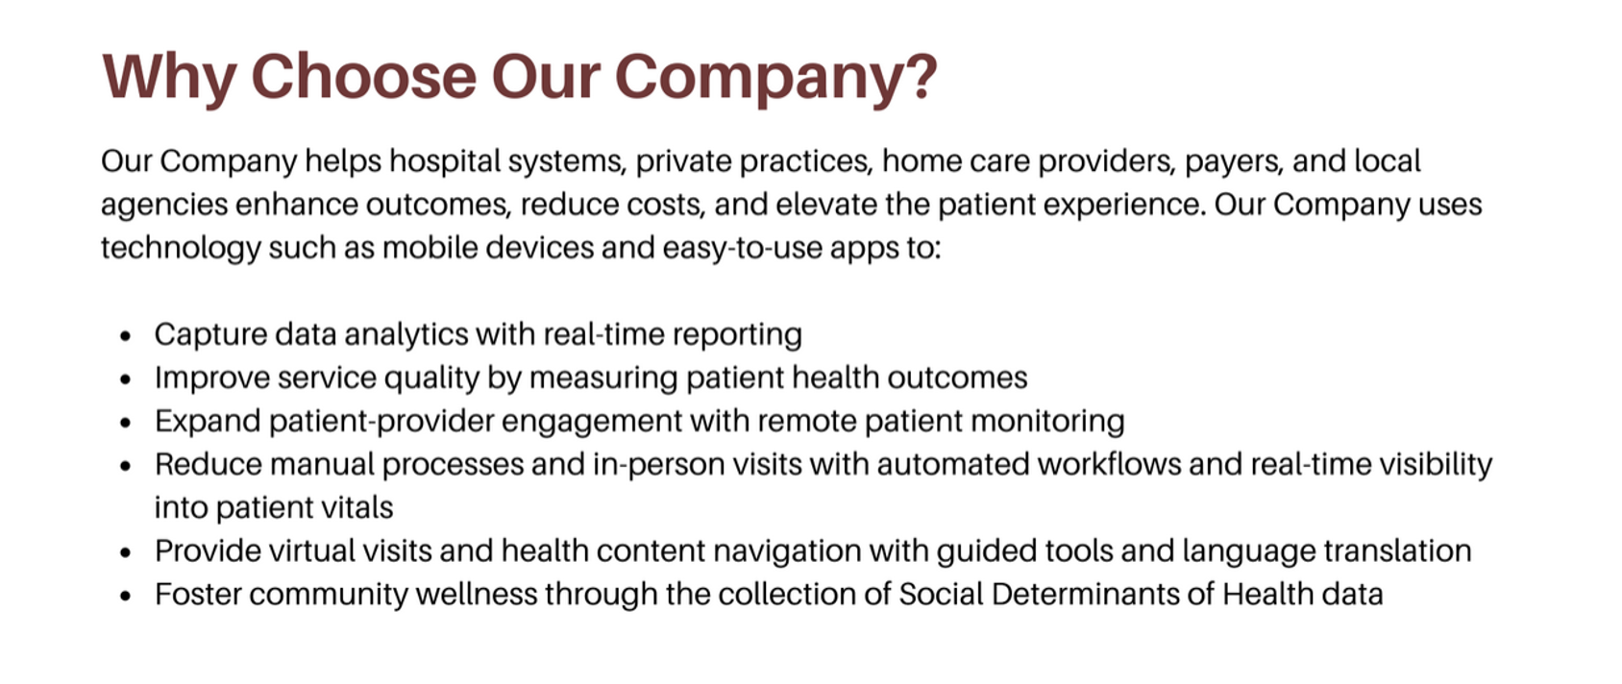
Why Choose Our Company?
Example #1
Original: Non-plain language
Rewrite: Plain language
Notes:
Our first example presents marketing content from a healthcare company. Long sentences and heavy language in the original content bog down the reader. We offered a plain language alternative, using bullet points for easier reading. Action verbs also make it simple to understand the benefits of the offer. Survey participants had a distinct preference for plain language.

Slide 8
Original
©2024 Aha Media
8

Slide 9
Rewrite
©2024 Aha Media
9
Notes:
Note the first sentence of the opening paragraph. It clearly defines who this information is for. It helps the reader self-select if this content is right for them.
Using bullet points breaks up a long paragraph and allows readers to scan for needed information.

Slide 10
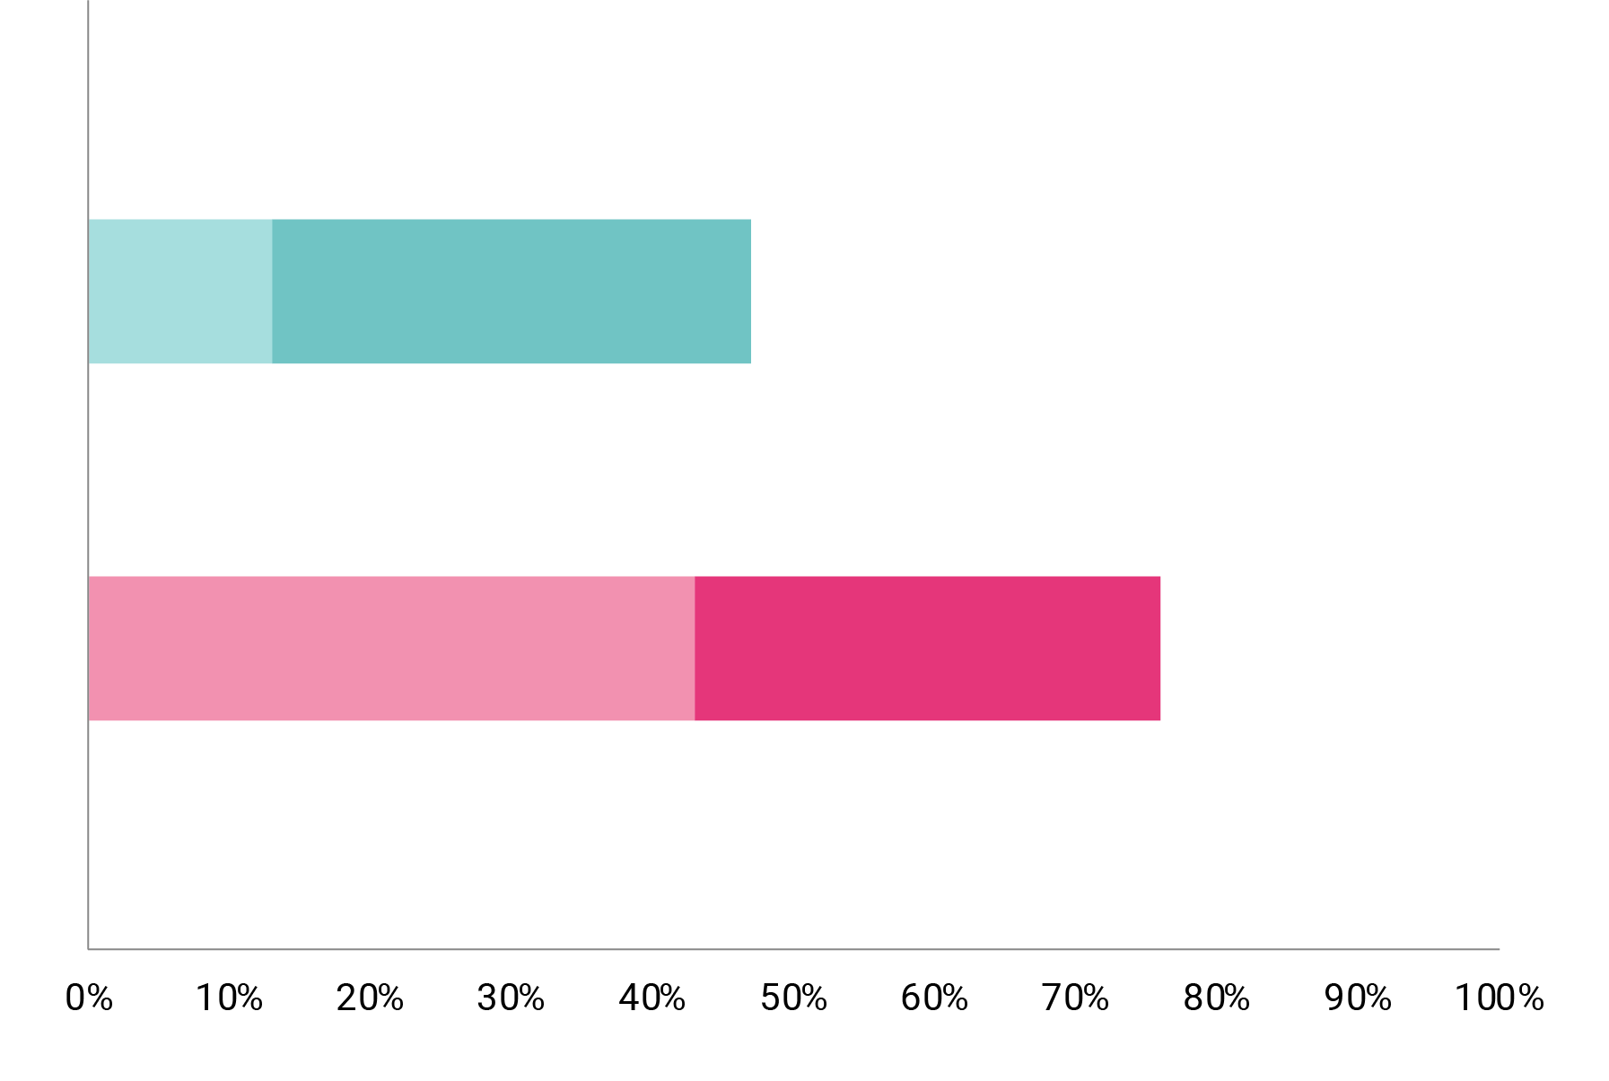
How Clear Is This Description?
Not Plain
Very
Somewhat
Plain
Very
Somewhat
47%
76%

Slide 11
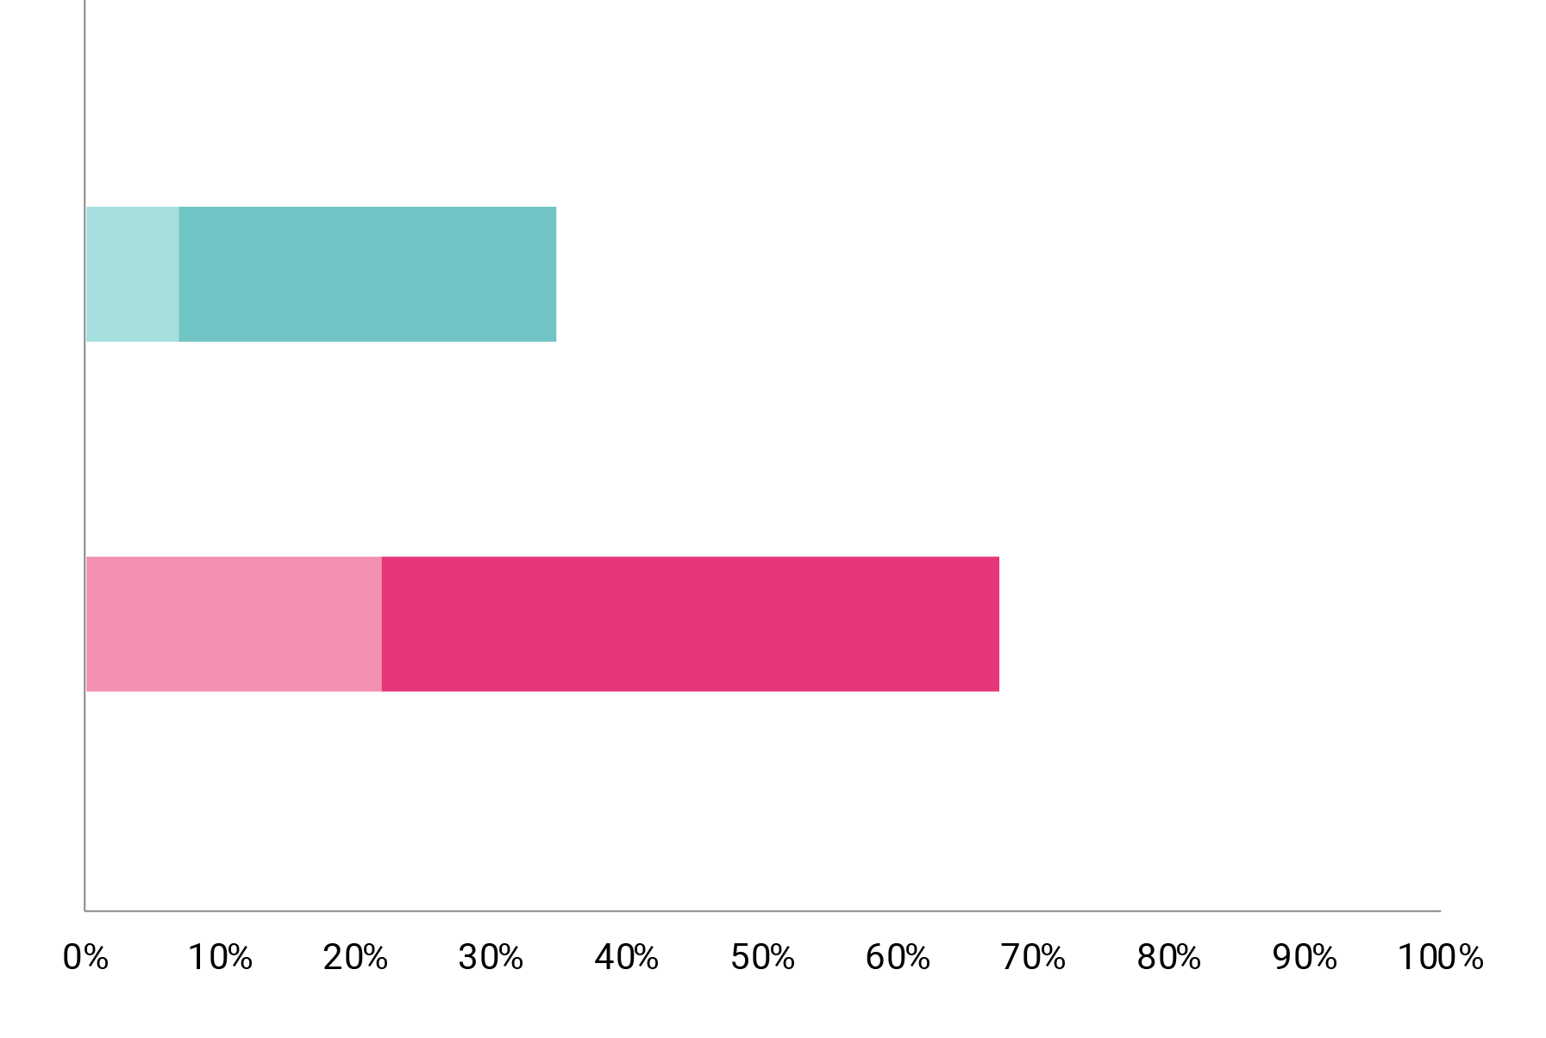
How Likely Would You Be to Reach Out to the Company?
Not Plain
Very
Somewhat
Plain
Very
Somewhat
35%
68%

Slide 12
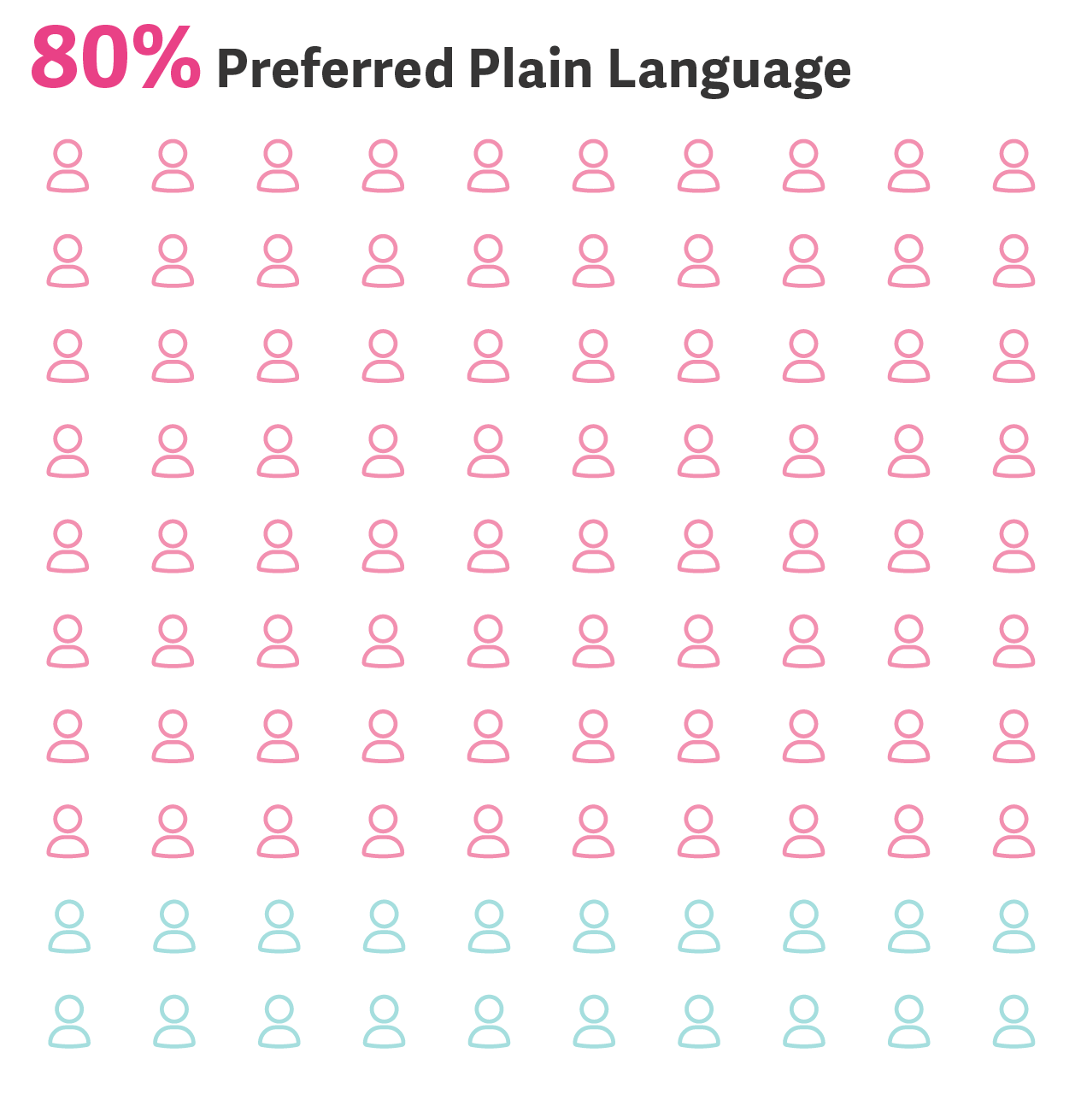
Which of the Two Versions Do You Prefer?
80%
Prefer the plain language example

Slide 13
The run-on sentences in the original content make it hard to read and believe.”
Study Participant

Slide 14
It takes less work to unpack the message ... We are short on time. Concise messaging is better.”
Study Participant

Slide 15
What Is Plain Language?
It’s not dumbed down language. It’s strategic language that helps people:
Find What They Need
Ex: Use the term “digital tomosynthesis” in the text, but call the page “Medical Imaging” because it has higher search volumes.
Understand What They Find
Write using short sentences, chunks, headlines and bullets.
Use What They Find to Decide How to Move Forward
Make the next steps clear.

Slide 16
Find
SEO: Optimize content with keywords and ensure your site has a clear, searchable structure.
UX design: Design a clean layout with easy navigation, fast loading times and a visible search function.
Using these methods ...
Content clarity: Use headings, summaries and bullet points for easy scanning.

Slide 17
Understand
Clear language: Use simple terms and avoid medical jargon to ensure readers can easily understand content. Define difficult terms when used.
Visual aids: Incorporate diagrams, infographics or videos to help explain complex concepts or data.
Using these methods ...
Examples and analogies: Relate complex healthcare topics to everyday experiences, making them more understandable.

Slide 18
Act
Direct CTAs: Use clear calls to action to guide users. The goal of your page? That should be the CTA.
Engagement tools: Use tools like calculators or assessments that prompt personalized pathways.
Using these methods ...
Reduce friction: Simplify processes, reduce steps and integrate features like click-to-call or chat.

Slide 19
Plain Language Rules
Use bullet points and text chunking
Remove jargon and define difficult terms
Use active voice
Best practices to follow.
Shorten sentences and remove extra words
Create benefits-focused headlines
Use words that make users want to act
©2024 Aha Media
19
Notes:
Our findings are clear: 80% of healthcare professionals prefer plain language in content, demonstrating that clarity leads to action. Plain language, defined as content that speaks directly and clearly to the reader, significantly increases engagement and comprehension.
Plain language isn't about "dumbing down"; it's about ensuring your message is accessible and understandable. It's respecting the intelligence of your audience while acknowledging the need for clarity. This approach fosters trust and informed decision-making.
As content marketers, you are communication experts, just as physicians are experts in their field. Approach your role with confidence, using data to support the adoption of plain language in all communications.
Your expertise in crafting clear, concise content is invaluable in bridging the gap between complex medical information and actionable knowledge.

Slide 20
Lacey Reichwald
lacey@ahamediagroup.com

